Slide 1











PROJECT PRESENTATION
Group 5
Recipe search project
www.themealdb.com

Slide 2
Requirement gathering
01 Must
02 Should
03 Could
04 Won’t
search by main ingredient
display the recipes found
filter the results based on user criteria
sort the results based on user criteria (e.g. vegan / non-vegan
add a terminal-based user interaction
search by multiple ingredient
search random recipe
search by meal name
save results to a txt file
Cross-reference the ingredient against the Edamam nutrition analysis API

Slide 3
Margarita:
terminal based interaction / menu
search random meal
search by meal name
01.
Work distribution
01.
Orsi:
search by main ingredient
display meal details on screen
save results to a txt in user friendly way
integrated Nadia’s code into the menu
02.
Collaboration tool used: github
Tasks assigned through Issues feature on github
Everybody worked in separate branches and merged the code into main once done via PR
Joanna:
search by multiple ingredient
integrate features with search by main ingredient
03.
Nadia:
search by main ingredient and display meal detail on screen
sort by category: vegan / non-vegan
save recipe names to a txt file
04.

Slide 4
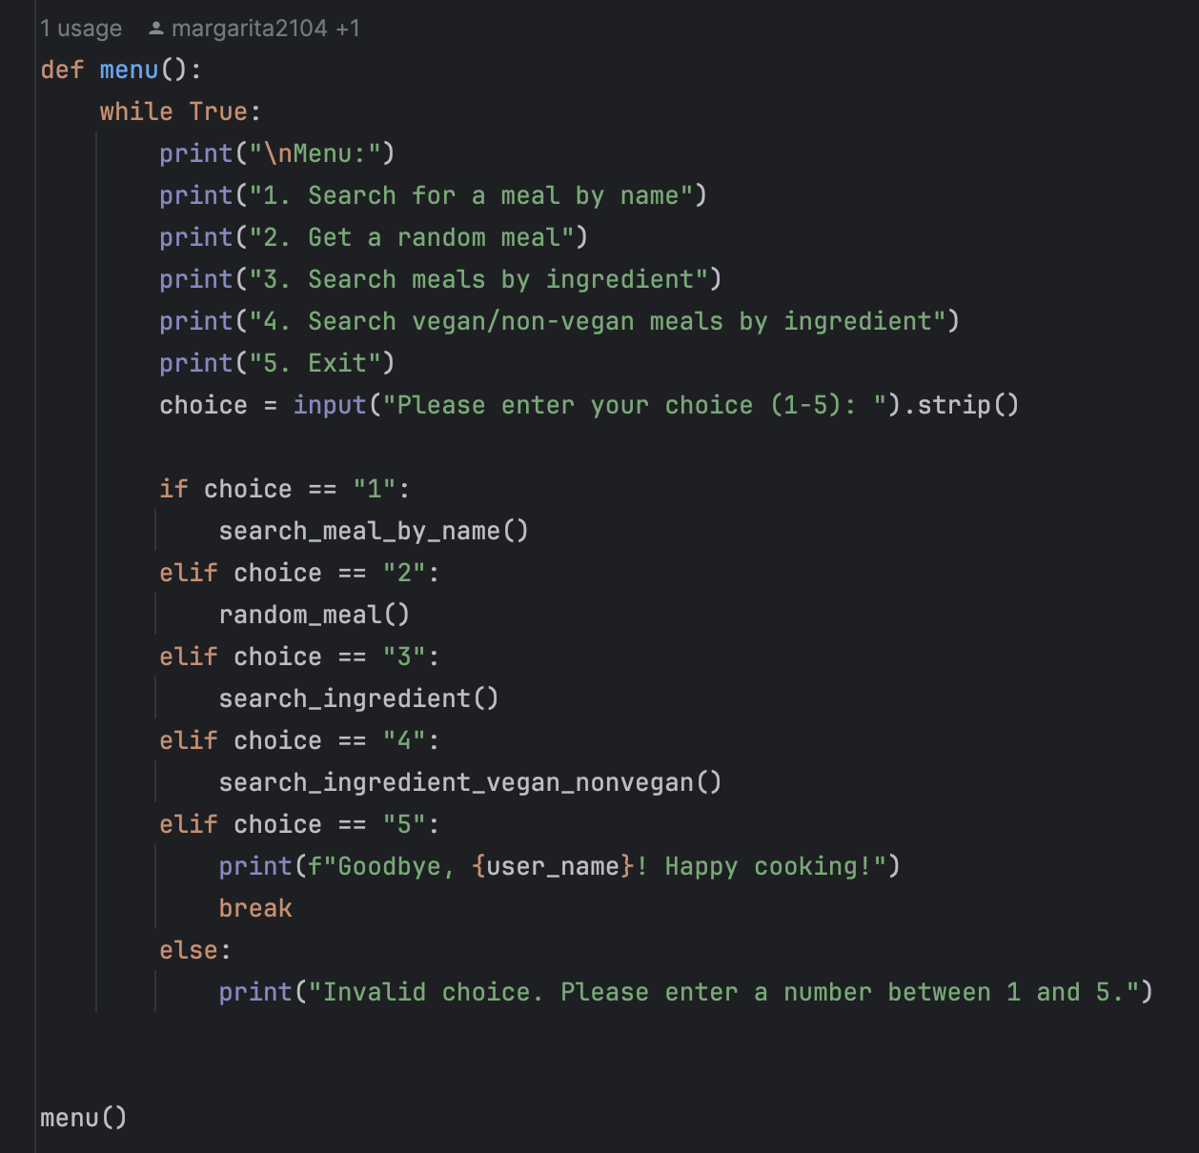
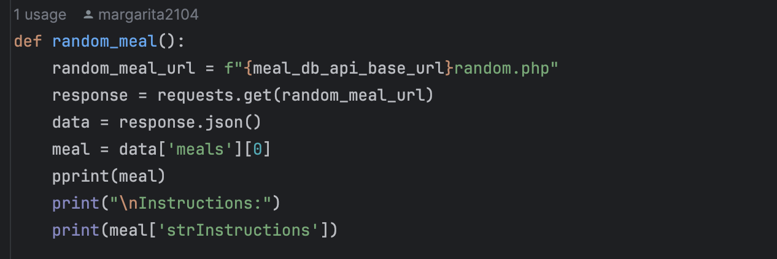
Margarita
Challenges:
Working around code from other teammates
Merge conflicts because I didn’t merge my code with the main branch
Working around limitations of the API, had to go with a different API
Takeaways:
Keep in mind that not everybody uses MacOS (different terminal commands)
Should practice more Python ☺

Slide 5
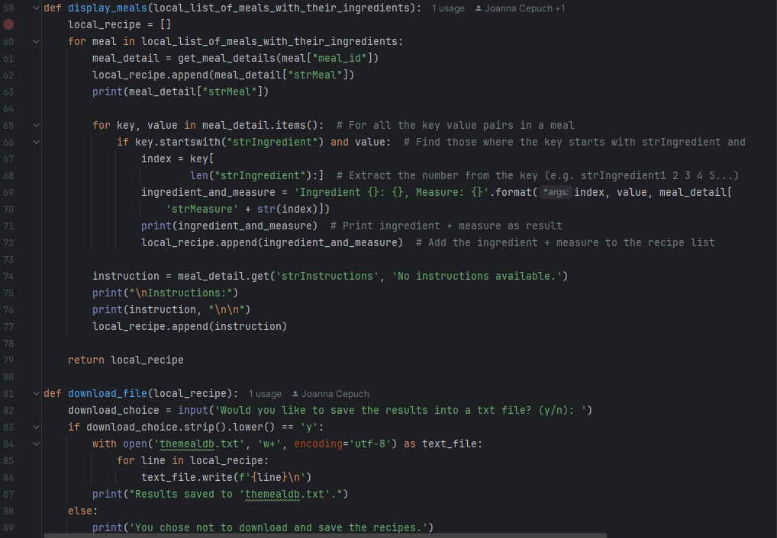
Orsi
Challenges:
learning basics of github
collaboration due to different level of experience / understanding someone else’s code
unicode problem faced during save to txt
ingredient and measure printing in a user-friendly format
Takeaways:
Windows / Mac and Python 2.7 / 3 differences can cause issues in collaboration

Slide 6
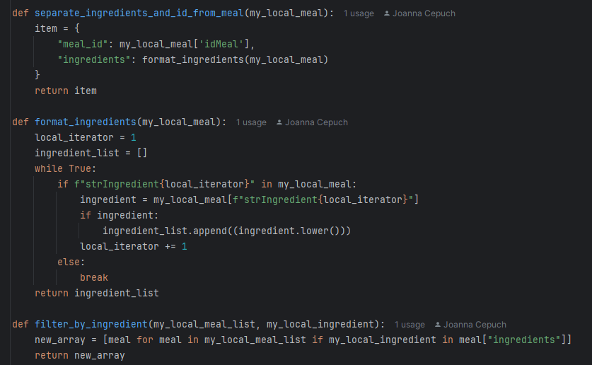
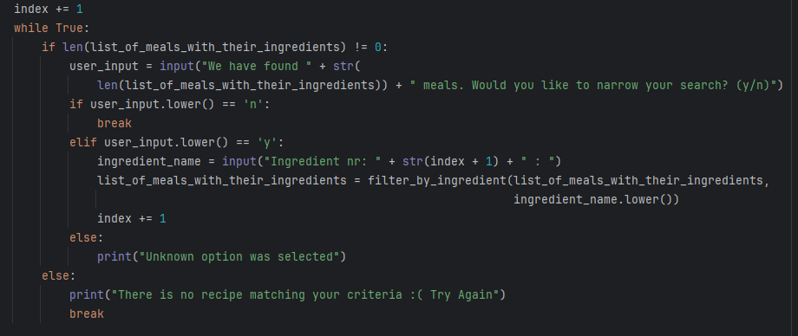
Joanna
Joanna
Challenges:
API analysis and deciding on the best strategy to overcome its limitations
Takeaways:
We should look for long-term solutions

Slide 7
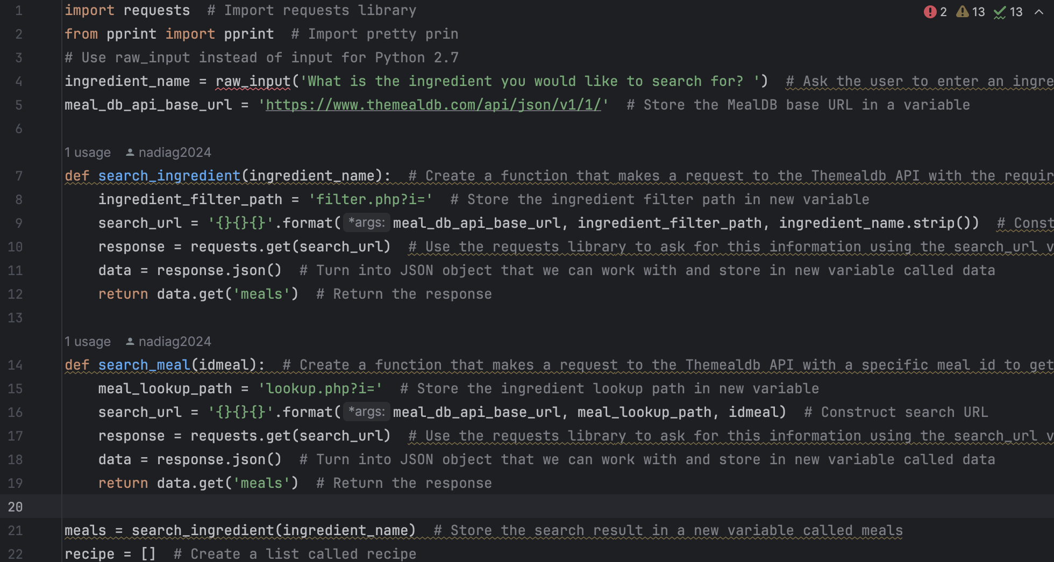
Nadia
Challenges:
Takeaways:

Slide 8
THANK YOU VERY MUCH!

